Slide 2
EE 295
TechWriting-Engineering Ethics
Aug 29, 2019
Room E339
Tom Wrappe
EE Lecturer

Slide 3
Advisory to Section 1
-The Lecturer will not be able to hold the Section 1 class on Tue, Sep 3 @4:30pm
+Makeup session at Section 2 Room E339 @ 7:30pm (All materials posted)
+Alternative potentially at 6pm Thu, Sep 5 @ location TBD (Discussion in Aug 29 class)

Slide 4
-Engineering Ethics 101
-Engineering Project: Chapter 1 -Engineering Process
-Applying Writing Methods/Rules
-Upcoming Week

Slide 5
Engineering Ethics
Engineering Ethics Video: Michael Liu, Uof Illinois

Slide 6
Engineering Process
Premodern Era :
Pyramids to Medieval Cathedral
Process emerging
Know-how driven by experience
Passing of experience by apprenticeships
Emergence of Scientific Method in late Medieval Age
Mathematics and scientific theory provided tools
Means, methods, procedures emerged for engineering
Rene Descartes (1596-1650) formulated his “Method” that fit the Engineering Process
Abstraction
Dissection
Reconstruction
Control
Analysis
Synthesis

Slide 7
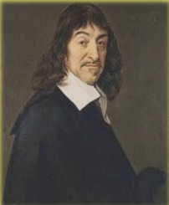
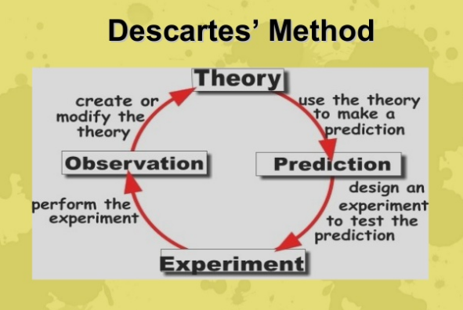

Slide 8
Engineering Professionalism
-Modern Engineers should hold themselves to standards that exceed what the law, the market, and ordinary morality should require
+Knowledge
+Autonomy
+Obligation
+Commitment

Slide 9
Groups Discussion: General
1. Science and Engineering
Engineering is a series of steps that deliver a product or design
How do Science and Engineering differ in
Starting point: Requirements versus Theory
Goals : Knowledge versus ultimate practice
Process : Use of approximation versus pure deduction
Deliverables: Useful products versus proof of validity of theory
Customer: Clear client versus “expanded universe”
2. Defective Chips
Plan that is both ethical and cost effective

Slide 10
In Class Group Discussion: Defective Chips

Slide 11
Defective Chips
Narrative:
Shane, a production line engineer, is checking every chip for Quality Control. There are approximately 1 defective chip every 150 chips. The defective chips are either repaired or thrown away. The Manager, Rob, states that it is too expensive to repair the defective chips and it is too expensive to discard them. Rob states that it would be more beneficial to let all the chips go out the door.
Facts:
The line produces 100,000 chips per year.
Every chip is purchased
Chips cost about $9.00 to produce.
Chip testing costs about $4.00 per chip
Chip repair is about $2.00
Profit per chip is $0.25 after testing
There are 15 full-time employees under Shane
Rob has been with the company for over 7 years.
Shane has been working for Rob for about 5 years
***Recommend a plan. Prove that it is both ethical and cost-effective.**
Taken from NSF Case Study by Jeremy Hanzlik

Slide 12
Progression of Ethical Analysis
What is the purpose?
Key Facts
What are the options to accomplish the purpose?
Compare the options and recommend ONE
Back up your work

Slide 13
Semester Major Items…..(subject to modification)
 | Mid Term | Resume | Final Paper | Final Presentation (slides )
Topic Paragraph | 9.5.19
Topic Proposed | 9.12.19 |  | 10.3.19
Topic Final | 9.19.19 |  | 10.10.19
Outline/ Abstract | 9.26.19 |  | 10.31.19
Research | 10.1.19 | 10.24.19 (Class) | 10.15.19
Draft Complete | 10.10.19 |  | 11.7.19 | 11.19.19
Final Submit | 10.22.19 | 11.14.19 | 11.26.19 | 12.3.19
Final Presentation | NA | NA | NA | 12.17.19 (Sect 1) 12.12.19 (Sect 2)

Slide 14
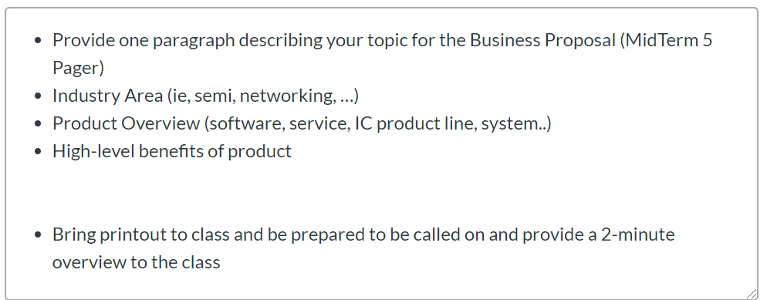
In Class Sep 5: Midterm Topic Paragraph

Slide 15
Six Step Method to Reader Centered Writing
Step 1 Analyze your purpose and audience by using the focus sheet
Step 2 Generate Ideas by using a start-up strategy
Step 3 Organize your information
Step 4 Sequence your ideas. The bottom line should go on top– most of the time
Step 5 Write the first draft
Step 6 Edit for clarity, conciseness and accuracy

Slide 16
Adaptable Black Box Approach to Tech Writing Process
Content
Clear Conclusion
Concisely Stated
Well Supported
6 Edit
2 (Ideas), 3 (Organize), 4 (Sequence)
Generate Technology
Document
(FPGA)
5 Draft
EE 295 Rules
Rules
Grammar
295 No No’s
Plagiarism
Inputs
Step 1: Configured to Meet type of Document
-Product Description
-Patent application
-Business Case
-Research Paper
(Firmware)
Output
Metrics

Slide 17
SJSU Writing Center Resource
-Support and Review
Research Papers
Out of Class Exercises
Resumes, Cover Letters
-MLK Library, 2nd floor and Clark Hall 126
SJSU.edu/writingcenter

Slide 18
Technical Communication for Engineers Formal Reports – An Introduction
Dr. James Freeman,
Professor Electrical Engineering, SJSU
Dr. Nancy Freeman,
Technical Communications Consultant

Slide 19
The Importance of Writing
Engineers perform technical writing to communicate pertinent information that is needed by upper management to make intelligent decisions that will impact a company’s future.
Upper Management
Decision Control
Detailed Knowledge
Project Engineer

Slide 20
Technical Writing
Technical writing is a type of expository writing this is used to convey information for technical or business purposes.
Technical writing is NOT used to:
entertain
create suspense
invite differing interpretations
Notes:
Note: Expository means serving to expound, set forth, or explain. (Random House Webster’s College Dictionary)
Reference:
Newman, J. M. (2006). Resources for technical and business writing: Glossary. Retrieved August 3, 2006 from http://www.lupinworks.com/roche/pages/glossary.php

Slide 21
Types of Formal Reports Documents
These documents can be the final link in a chain of documents in a specific assignment or project.
There are four Basic Types of Formal Reports:
1. Informational reports present results and facts
2. Analytical reports analyze information and present conclusions or interpretations of the results. They can show cause and effect relationships. They help the writer and reader better understand the problem.
They describe: Why something happens
How it happens
What it means

Slide 22
Types of Formal Report Documents
3. Recommendation Reports advocate certain courses of action. The recommendations flow directly from conclusions.
4. Feasibility Report is a special type of recommendation report.
Answers three kinds of questions
1. Possibility
2. Economic Wisdom
3. Perception

Slide 23
Different Reports in EE295
Type | EE 295 | Comment
Information Report | Gadget Description | Identify the physical, logical and functional description of a complex product
Analytical Report | Engineering vs Science | Why, how and what
Recommendation Report | Midterm Proposal | Propose and describe a product for a startup or an incremental product for a larger enterprise
Feasibility Report | Midterm/Final Reports | Possibility Economic Wisdom Perception/ Conclusion

Slide 24
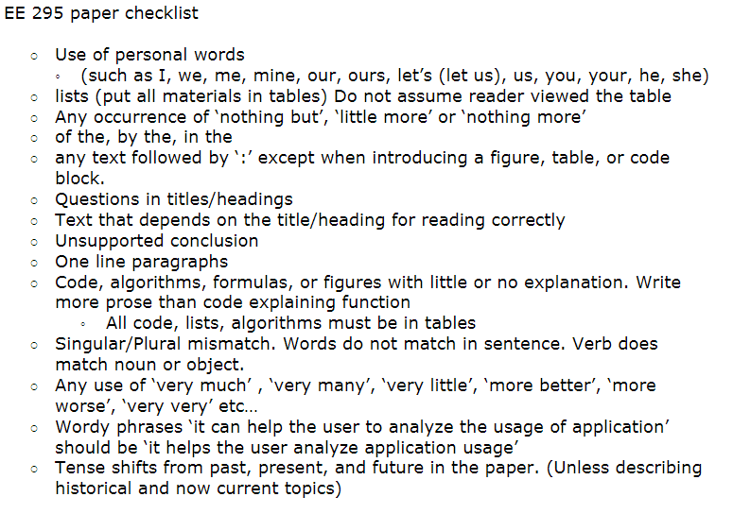
-Morris Jones, EE295 Fall 2016
Minimize use of passive voice. Instead utilize active wording…

Slide 25
Focus on EE295 Items
No personal forms --> I, we, me, us, my, mine, our, ours, you, your, yours, let's (let us), it, etc.
This is a cold heartless IEEE professional document.
Can use 'One' or synonyms when needed
“The data suggests that approach A is the best choice” rather than “I choose approach A”
No 'of the', 'by the', 'in the' ... (Unless required)
Watch excessive use of 'of'
Typically a grammar problem (Word order)
“the measurement of voltage ---> the voltage measurement”
“the professor of the class --> the class professor”
All paragraphs have three sentences minimum:
An introduction or topic (one subject only)
A body or argument
A conclusion

Slide 26
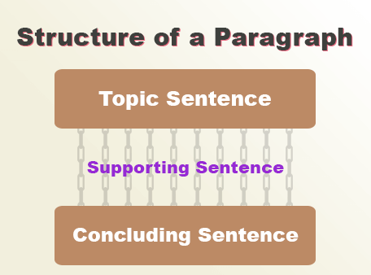
Paragraph
“Students must improve their understanding skill as well as time management skill to get desired scores in the tests. To master each subject and enhance each skill, they must practice old question papers and reference study materials. Additionally, they can practice sample question papers to understand the pertinent exam pattern and marking system. However, to improve their skills, students must follow a strict academic routine.”

Slide 27
Watch Out List for Tech Writing
Things to avoid

Slide 28

Avoid extra ‘as’
Called as
Named as
Said as
Referenced as
Told as
Describe as
Termed as

Slide 29

Avoid “I won’t tell you” words
Certain
Various
Specific
Obvious
Exigent
Different

Slide 30

Time – terms to avoid (confusing)
Nowadays → currently, at present
In these times → now, currently
In prior times → previously
Before the current → previously
In the current time → now
Brought to light → ?
Come to be → ?

Slide 31
Titles and Headings
Only used to find areas in a document
Never assume they are read
No text should refer to a heading
Watch pronouns
Never have two headings in a row
No ‘-’ or ‘:’ or any combination of the two
No headings in line
Then called a ‘list’

Slide 32
Headings
Should have at least 4 paragraphs per heading
Flow without headings should be good
Never ever ever ever cite a heading

